Slide 1
Classification Metrics
MACHINE LEARNING EXPERT

Slide 2
Classification Metrics
Classification metrics are used to evaluate the performance of classification models, which predict categorical or discrete values.
Types of Classification Metrics
Confusion Matrix
Accuracy Score
Recall Score
Precision Score
F1 Score
AUC ROC Curve
MACHINE LEARNING EXPERT

Slide 3
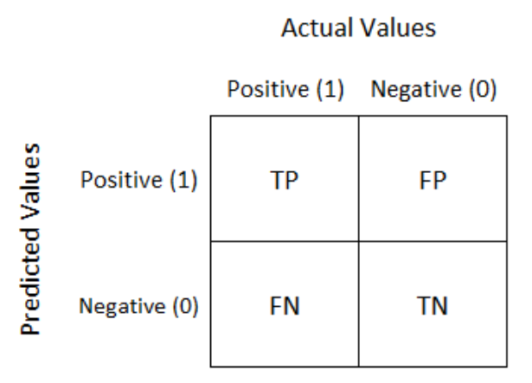
Confusion Matrix
Confusion metrics is a 2 * 2 matrix which describes the performance of the models.
where the output can be two or more classes. It is a table with combinations of predicted and actual values.
MACHINE LEARNING EXPERT

Slide 4
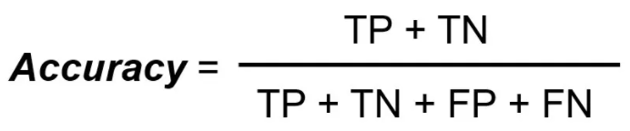
Accuracy Score
Accuracy Score simply measures how often the classifier correctly predicts. We can define accuracy as the ratio of the number of correct predictions and the total number of predictions.
MACHINE LEARNING EXPERT

Slide 5
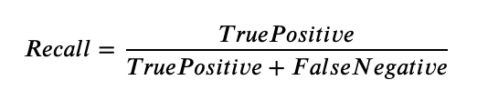
Recall Score
Recall Score Gives out of total actual positive, how many are
correctly predicted as positive.
False Negative is knowns as Type 2 error.
MACHINE LEARNING EXPERT

Slide 6
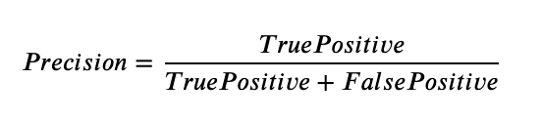
Precision Score
Precision Score tells us out of total predicted positives, how many are correctly positives.
False Positive is knowns as Type 1 error.
MACHINE LEARNING EXPERT

Slide 7

F1 Score
F1 Score gives harmonic mean of precision and recall score.
MACHINE LEARNING EXPERT

Slide 8
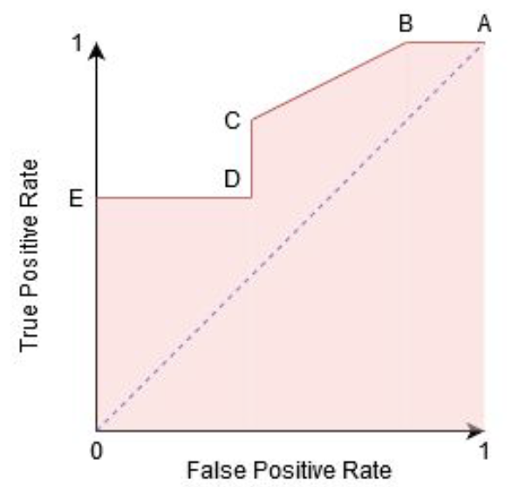
AUC ROC Curve
AUC ROC is stand to Area under curve Receiver operating characteristic.
AUC ROC Curve is a probability curve that plot true positive rate against the false positive rate at various threshold.
MACHINE LEARNING EXPERT

Slide 9
Questions?
Q&A Session
MACHINE LEARNING EXPERT

